Slide 1
3
Structured Program Development in C

Slide 2
Let’s all move one place on.
Lewis Carroll
The wheel is come full circle.
William Shakespeare
How many apples fell on Newton’s head before he took the hint!
Robert Frost
All the evolution we know of proceeds from the vague to the definite.
Charles Sanders Peirce

Slide 3
OBJECTIVES
In this chapter you will learn:
Basic problem-solving techniques.
To develop algorithms through the process of top-down, stepwise refinement.
To use the if selection statement and if...else selection statement to select actions.
To use the while repetition statement to execute statements in a program repeatedly.
Counter-controlled repetition and sentinel-controlled repetition.
Structured programming.
The increment, decrement and assignment operators.

Slide 4
3.1 Introduction
Before writing a program:
Have a thorough understanding of the problem
Carefully plan an approach for solving it
While writing a program:
Know what “building blocks” are available
Use good programming principles

Slide 5
Software Engineering Observation
Experience has shown that the most difficult part of solving a problem on a computer is developing the algorithm for the solution. Once a correct algorithm has been specified, the process of producing a working C program is normally straightforward.

Slide 6
Steps in Problem Solving
First produce a general algorithm (one can use pseudocode)
Refine your steps until you get to an easy sequence. Perhaps use numbers or bullets. The point is to simplify.
Pseudocode is an artificial and informal language that helps programmers develop algorithms. Pseudocode may be an informal english, combinations of computer languages and spoken language. Whatever works for you.

Slide 7
Example:
Write an algorithm to determine a student’s final grade and indicate whether it is passing (>60) or failing. The final grade is calculated as the average of four marks.
Pseudocode:
Input a set of 4 marks
Calculate their average by summing and dividing by 4
if average is below 60
Print “FAIL”
else
Print “PASS”

Slide 8
Basic and most common algorithm symbols are shown here.
Diamond is decision symbol. Rectangle is process symbol.
Parallelogram is input-output symbol. Cycle is the terminal symbol.

Slide 9

Example:
Draw the flowchart of an algorithm which finds the sum of two numbers N and M

Slide 10
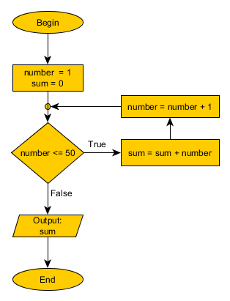
Example:
Draw the flowchart of an algorithm which finds the sum of the first 50 numbers

Slide 11

Diamond symbol (decision symbol)
Indicates decision is to be made
Test the condition, then, follow appropriate path
Contains a test condition that can be true or false
Pseudocode:
If student’s grade is greater than or equal to 60 Print “Passed

Slide 12
3.5 The if selection statement
if selection structure is used to choose among alternative courses of action
if (condition)
statement 1;
If condition true
Print statement executed and program goes on to next statement
If false, print statement is ignored and the program goes onto the next statement
Notes:
if the condition is true, the codes inside the selection block is executed.

Slide 13
3.5 The if selection statement
General Form: if the condition is true then statement 1 is executed. If the condition is false then statement 1 is skipped.
if (condition)
statement 1;
A compound statement or block, which is composed of a set of statements enclosed in braces, can also be used.
if (condition)
{
statement 1;
statement 2;
…
statement n;
}
Example
if (a < 50)
{
count=count +1;
sum =sum + a;
}
Curly braces show the borders of the compound statement or block. If there is only one statement inside the block, there is no need to use braces.

Slide 14
3.5 The if selection statement
if statements can also be nested:
Example:
if (a < 50)
{
count=count +1;
sum = sum + a;
if (b > a)
b = 0;
}
Any if statement can be inside another if statement.

Slide 15
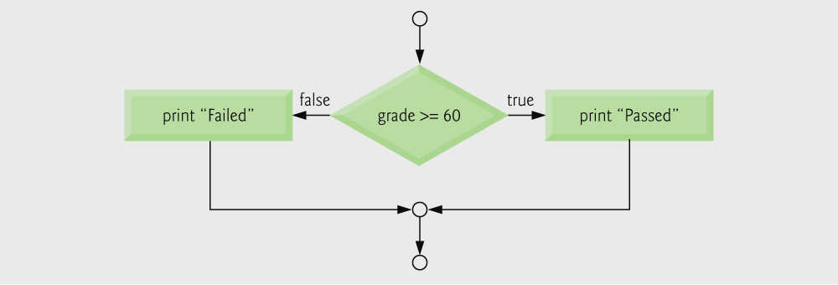
3.6 The if…else selection statement
if
Only performs an action if the condition is true
if…else
Specifies an action to be performed both when the condition is true and when it is false
Psuedocode:
If student’s grade is greater than or equal to 60 Print “Passed”
else Print “Failed”

Slide 16
3.6 The if…else selection statement
The if/else statement allows to execute one set of statements if a condition is true and a different set if the condition is false.
General Form:
if (condition)
statement1;
else
statement2;
Statements 1 and 2 can also be an empty statement, which is a semicolon.
if (a < b)
;
else
count=count +1;
Empty statement

Slide 17
3.6 The if…else selection statement
Example:
if (x > y)
if (y < z)
k++;
else
m++;
else
j++;
Please pay attention to the indentation usage. There is only one statement in each block. So, there is no need to use braces. Last statement belongs to the outer if block

Slide 18
3.6 The if…else selection statement
Identation is just for style and it does not change interpretation.
if (x > y) if (y < z) k++; else j++; (same) | if (x > y) if (y < z) k++; else j++; (same) | if (x > y) { if (y < z) k++; } else j++;

Slide 19
What is the output of the following code? #include <stdio.h> int main() { int x=1, y=2, z=3, k=0 , j=0; if (x > y){ if (y < z) k++;} else j=j+1; printf("k=%d, j=%d\n",k,j); return 0; }
Q

Slide 20
Write a program that reads in four integers from the keyboard and then calculates the sum of the numbers which are positive. The screen dialogue should appear as follows:
Input four different integers: 14 18 11 -8
Q
#include <stdio.h>
#include <stdlib.h>
int main()
{
int x1, x2, x3, x4;
int sum=0;
printf("Input four different integers: " );
scanf("%d%d%d%d",&x1, &x2, &x3, &x4);
if (x1>0) sum=x1;
if (x2>0) sum=sum+x2;
if (x3>0) sum=sum+x3;
if (x4>0) sum=sum+x4;
printf("The sum of the positive numbers is: %d\n",sum);
system("Pause");
return 0; /* successful termination */
}

Slide 21
Ternary conditional operator (?:)
Takes three arguments (condition, value if true, value if false)
Example:
printf( "%s\n", grade >= 60 ? "Passed" : "Failed" );
OR
grade >= 60 ? printf( “Passed\n” ) : printf( “Failed\n” );
OR
if ( grade >= 60 )
printf( "Passed\n");
else
printf( "Failed\n");
Condition

Slide 22
Q
Write a program (by using ternary operatör) that reads in one integer from the keyboard and then prints out a message whether integer is greater than zero or not. The screen dialogue should appear as follows:
Input one integer: 14
#include <stdio.h>
#include <stdlib.h>
int main()
{
int x1;
printf("Input one integer: " );
scanf("%d",&x1);
x1 > 0 ? printf("Greater than zero\n" ) : printf("Less than zero\n");
system("Pause");
return 0; /* successful termination */
}

Slide 23
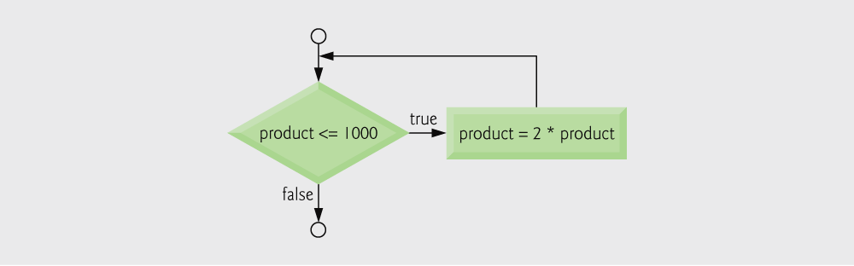
3.7 The while repetition statement
Example:
int product = 2;
while ( product <= 1000 ) product = 2 * product;
While loop is repeated until condition becomes false
While loop is repeated until condition becomes false
Pseudocode:
While there are more items on my shopping list Purchase next item and cross it off my list

Slide 24
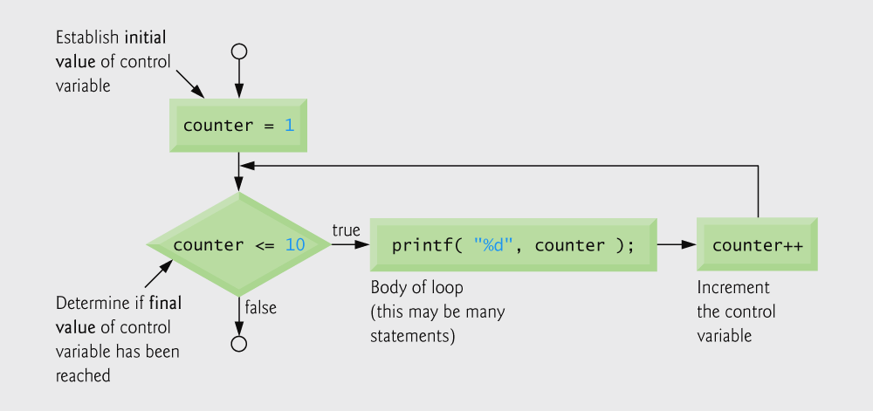
3.8 Counter-Controlled Repetition
Counter-controlled repetition
Loop repeated until counter reaches a certain value
Definite repetition: number of repetitions is known
if number of repetitions is known a counter is used to control repetition

Slide 25
Example: Ten students took a quiz. The grades (integers in the range 0 to 100) for this quiz are available to you. Determine the class average on the quiz.
Pseudocode of algorithm

Slide 26
Counter to control while loop
Initialize counter to 1
while loop iterates as long as counter <= 10
Increment the counter
Calculate the average

Slide 27
3.8 Sentinel Controlled Repetition
if number of repetitions is not known a sentinel (dummy) value is used to control repetition
Use sentinel value
Also called signal value, dummy value, or flag value
Indicates “end of data entry.”
Loop ends when user inputs the sentinel value
Sentinel value chosen so it cannot be confused with a regular input (such as -1 in this case)

Slide 28
Problem is:
Develop a class-averaging program that will process an arbitrary number of grades each time the program is run.
Pseudocode algorithm that uses sentinel-controlled repetition to solve the class average problem.

Slide 29
float type indicates variable can be a non-integer

Slide 30
while loop repeats until user enters a value of -1
Ensures the user entered at least one grade
Converts total to float type
Prints result with 2 digits after decimal point

Slide 32
Common Programming Error
An attempt to divide by zero causes a fatal error.

Slide 33
3.10 Nested Control Structures
Problem
A college has a list of test results (1 = pass, 2 = fail) for 10 students
Write a program that analyzes the results
If more than 8 students pass, print "Raise Tuition"
Notice that
The program must process 10 test results
Counter-controlled loop will be used
Two counters can be used
One for number of passes, one for number of fails
Each test result is a number—either a 1 or a 2
If the number is not a 1, we assume that it is a 2

Slide 34
Pseudocode for examination results problem.

Slide 35
while loop continues until 10 students have been processed
if and else statements are nested inside while loop

Slide 38
Performance Tip
Assigning value (Initializing variables )
Initializing variables when they are defined can help reduce a program’s execution time.
int passes = 0;
int failures = 0;
int student = 1;

Slide 39
3.11 Assignment Operators
c = c + 3;
Assignment operator
The form
variable = variable operator expression;
can be rewritten as
variable operator= expression;
can be abbreviated as
c += 3;
using the addition assignment operator

Slide 40
Examples of other assignment operators:
d -= 4; is equal to (d = d - 4)
e *= 5; is equal to (e = e * 5)
f /= 3; is equal to (f = f / 3)
g %= 9; is equal to (g = g % 9)

Slide 41
3.12 Increment and Decrement Operators
Increment operator (++)
Can be used instead of c+=1
Decrement operator (--)
Can be used instead of c-=1
Preincrement
Operator is used before the variable (++c or --c)
Variable value is changed before the expression it is in is evaluated
Postincrement
Operator is used after the variable (c++ or c--)
Expression executes before the variable value is changed

Slide 42
3.12 Increment and Decrement Operators
If c equals 5, then
printf( "%d", ++c );
Prints 6
-------------------------------------------
printf( "%d", c++ );
Prints 5
In either case, c now has the value of 6
Variable is in an expression

Slide 43
3.12 Increment and Decrement Operators
When variable not in an expression
Preincrementing and postincrementing have the same effect
++c;
printf( “%d”, c );
Has the same effect as
c++;
printf( “%d”, c );
Variable is not in an expression

Slide 44
Fig. 3.12 | Increment and decrement operators.

Slide 45
Outline
fig03_13.c
c is printed, then incremented
c is incremented, then printed

Slide 46
Fig. 3.14 | Precedence of the operators encountered so far in the text.
Increment and decrement operators have highest precedence.
Multiplication have higher precedence than summation and subtraction.

Slide 47
Write four different C statements that each adds 1 from integer variable “x”.
Q
#include <stdio.h>
#include <stdlib.h>
int main()
{
int x1, x2, x3, x4;
x1=x2=x3=x4=1;
x1=x1+1; %1st
x2+=1; %2nd
x3++; %3th
++x4; %4th
printf("The results are: %d, %d, %d, %d\n",x1,x2,x3,x4);
system("Pause");
return 0; /* successful termination */
}

Slide 48
Q
What is the expected output of each of the following?
int i=3;
printf( "%d ", (--i + 3) );
printf( "%d", (i++ + 10) );
Answer:
5 12

Slide 49
What is the result of this logic statement?
Q
int i=5, j=10, k=20;
i > 5 * k % 3
i > 100 % 3
i > 1
5> 1
1

